Slide 1
Evaluation of Inventory and Supply Management in a Retail Pharmacy
Riddhi Shetty
24f1002603@ds.study.iitm.ac.in

Slide 2
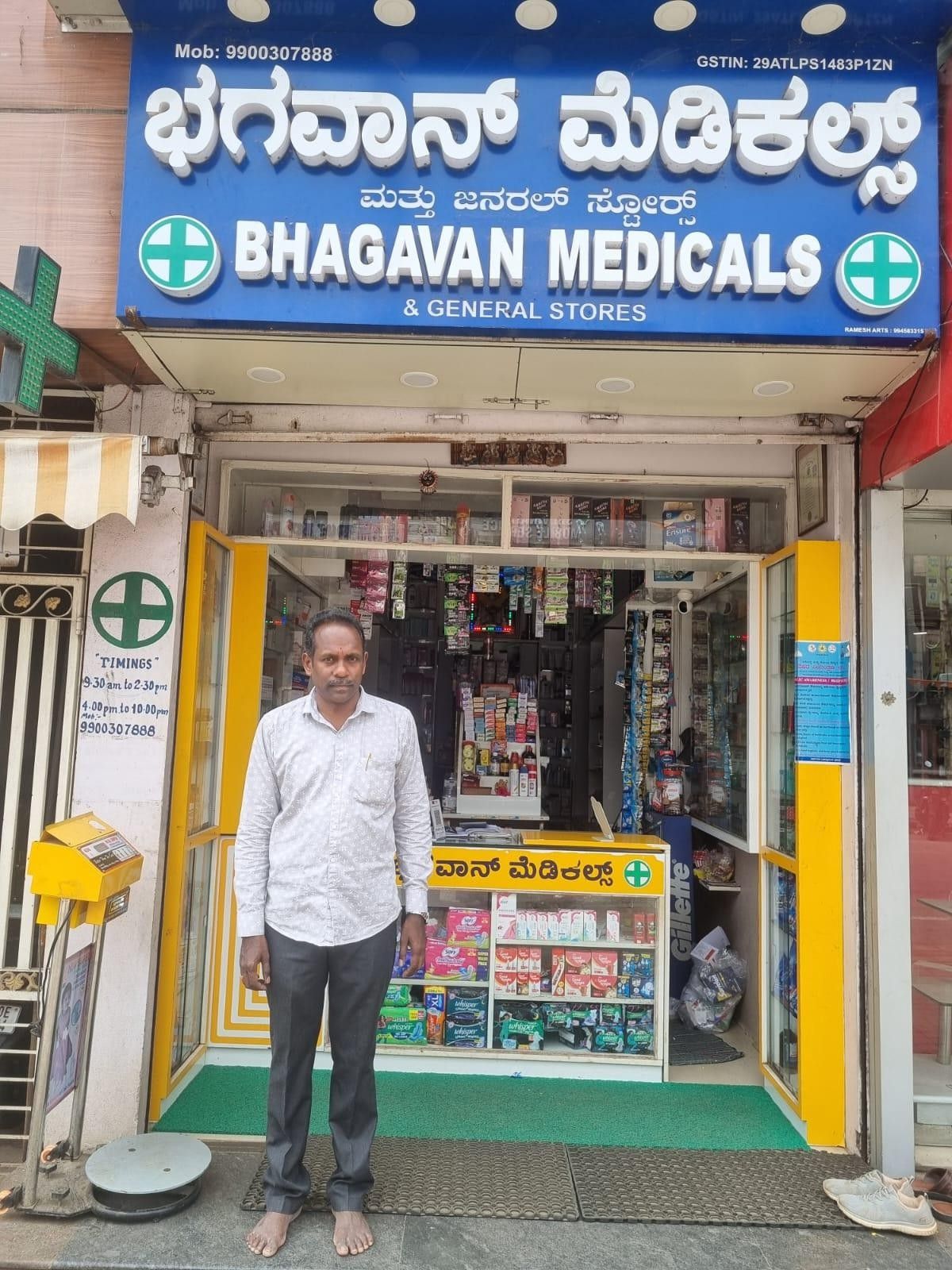
1. Business Background
Bhagavan Medicals is a retail pharmacy independently owned by Mr. Satish P.V, since 2011 in Yelahanka, Bengaluru.
.
The store functions under a B2C model, primarily offering prescription and over-the-counter medicines, with sales recorded manually.
Figure 1.1: Owner standing in pharmacy in 2025

Slide 3
2. Problem Overview
Manual Inventory Tracking
This method is time-consuming and prone to errors, leading to avoidable stock losses
Expiry Loss
Overstocking of medicines resulting in losses up to 22.97% of monthly revenue.
1
2
Experience-led Bias
Procurement decisions are based on experience rather than observed demand patterns.
3

Slide 4
3. Data Scope and Digitization
The dataset is item-level and manually digitized, enabling category-wise analysis of sales and expiry risk. The scope is short-term but sufficient to identify inventory inefficiencies and demand patterns.
Overview
Time period | October 2025
Data Source | Sales receipts and Expired products
Level of detail | Item-level transactions
Nature of Data | Sales Value, Quantity and Expiry information
Dataset Metrics
Sales data points | 539 rows and 11 columns
Classification | Items grouped into 14-broad categories
Expiry item detail | 45 product records
Analytical approach | ABC, FSN, EOQ and ROP

Slide 5





4. Analytical Approach
Sales and Expiry Data
Data Cleaning and Categorization
ABC and FSN Classification
Demand Variability Analysis
Inventory Control Methods
Digitalized from receipts and expiry records.
Standardized and grouped into 14 product categories
Products prioritized by their movement and revenue.
Used to understand demand patterns and stability.
Applied to guide stocking based decisions

Slide 6
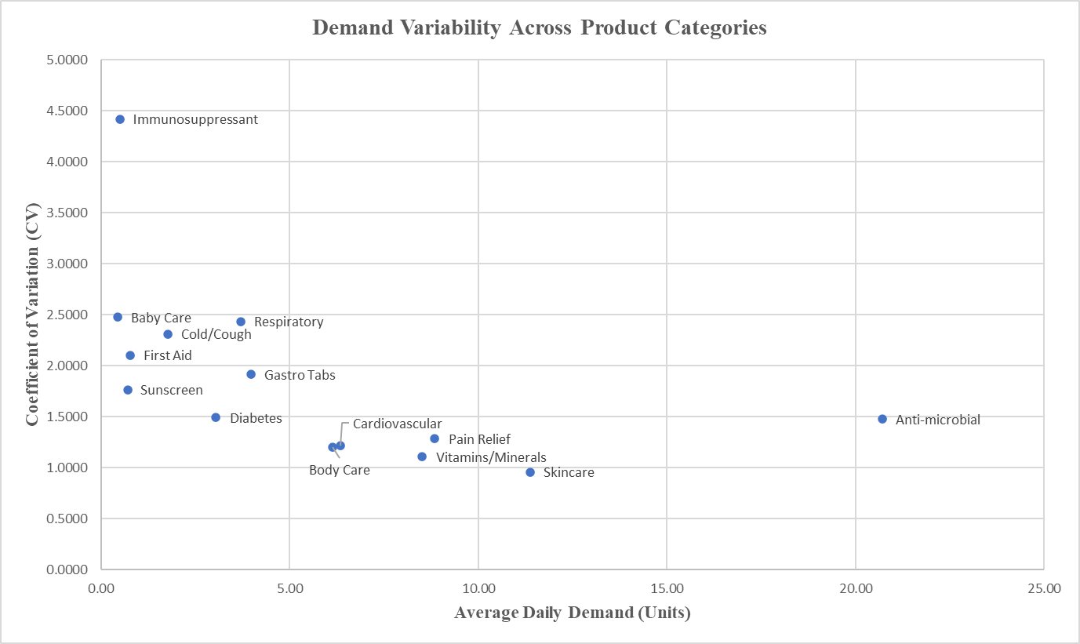
5. Core Analysis Methods
Figure 5.1: ABC–FSN Matrix Chart
Figure 5.2: Demand Variability Across Product Categories

Slide 7
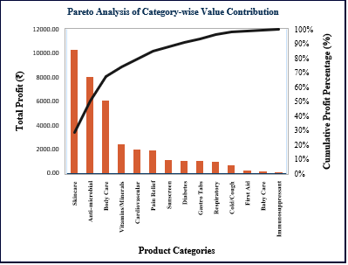
6. Demand and Sales Trends
Figure 6.1 : Pareto Analysis of Category-wise Profit Contribution
Figure 6.2: 7-Day Moving Average of Daily Revenue (October 2025)

Slide 8
7. Inventory Risk Insights
Inventory Risk Heat Map
Category | Expiry Risk | Demand Stability | Revenue Importance
Anti-microbial
Baby Care
Body Care
Cardiovascular
Cold/Cough
Diabetes
First Aid
Gastro Tabs
Immunosuppressant
Pain Relief
Respiratory
Skincare
Sunscreen
Vitamins/Minerals
High
Moderate
Low
Figure 7.2 : Inventory Risk Heat Map
Figure 7.2 : Inventory Risk Heat Map

Slide 9
8. Key Findings
Category | Expiry Risk | Stock Policy | Inventory Control Strategy
Skincare | HIGH | Small and Frequent Orders | Small batches ordered often to reduce expiry risk.
Anti-microbial | LOW | Bulk Order | Large quantity procurement for stable, low-expiry items.
Body Care | LOW | Bulk Order | Large quantity procurement for stable, low-expiry items.
Vitamins/Minerals | LOW | Bulk Order | Large quantity procurement for stable, low-expiry items.
Pain Relief | HIGH | Small and Frequent Orders | Small batches ordered often to reduce expiry risk.
Cardiovascular | MODERATE | Controlled Replenishment | Moderate ordering with regular stock review.
Sunscreen | MODERATE | Controlled Replenishment | Moderate ordering with regular stock review.
Diabetes | MODERATE | Controlled Replenishment | Moderate ordering with regular stock review.
Gastro Tabs | LOW | Controlled Replenishment | Moderate ordering with regular stock review.
Respiratory | LOW | Order on Demand | Procure only when demand arises.
Cold/Cough | LOW | Order on Demand | Procure only when demand arises.
First Aid | LOW | Order on Demand | Procure only when demand arises.
Baby Care | LOW | Order on Demand | Procure only when demand arises.
Immunosuppressant | HIGH | Prescription-based Stocking | Procure only against confirmed prescriptions
Implement ABC–FSN–based stock prioritization for regular reviews.
Inventory risk is concentrated in a few product categories
High sales volume does not always translate to low expiry risk.
Demand variability significantly influences expiry-related losses.
Table 8.1 : Recommendations for each category

Slide 10
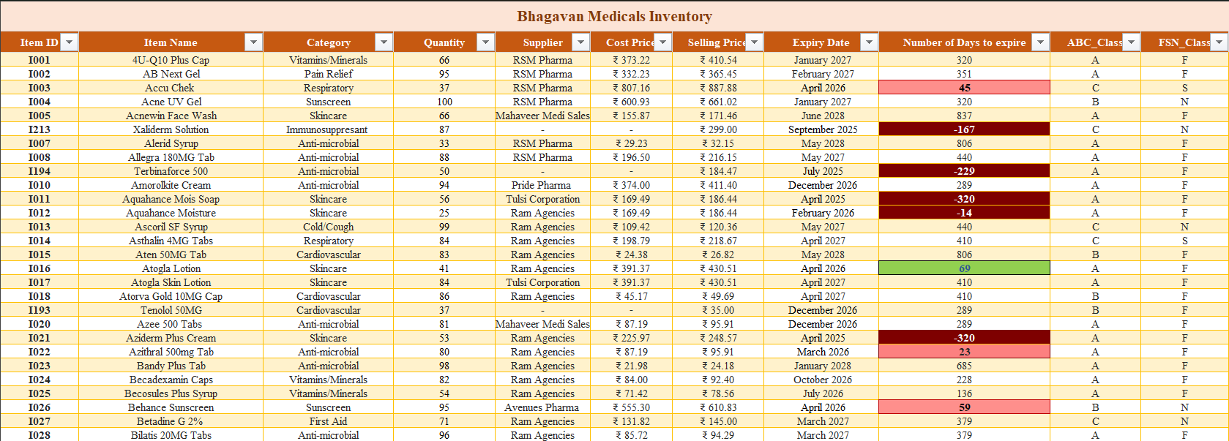
9. Recommendations
Figure 9.1 : Inventory Master Data with Expiry and Movement Classification

Slide 11
10. Limitations
DURATION
The data was collected over the duration of only a month, limiting the ability to observe seasonal variations
DATA ENTRY
As there is no point-of-sale system, manually collected data may contain minor inconsistencies.
REAL-TIME GAP
The proposed Excel-based system does not support real-time automation.

Slide 12
Thank you!

